Slide 1
Wave Properties

Slide 2
Wave Properties
1. AMPLITUDE is the measure of the ENERGY a wave carries or transfers.
**The greater the AMPLITUDE, the more energy the wave transfers.
- AMPLITUDE of a transverse wave is half the distance between a crest and a trough.
In a compressional wave, the tighter the medium is pushed together at a compression, the larger the AMPLITUDE.

Slide 3
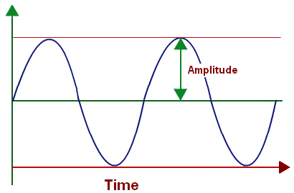
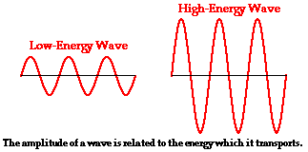

Slide 4
Wave Properties
2. WAVELENGTH is the distance between a point on one wave, and the identical point on the next wave. For example, from crest to crest or trough to trough.
- In transverse wave, from crest to crest or trough to trough.
In a compressional wave, from one COMPRESSION to the next or from one RAREFACTION to the next.

Slide 5
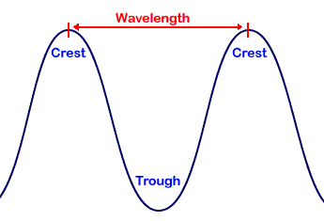

Slide 6
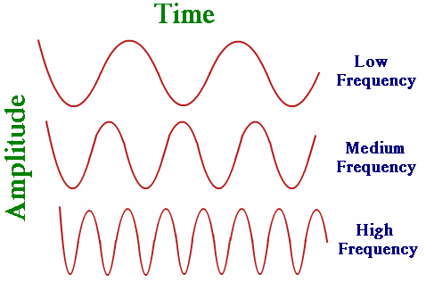
Wave Properties
3. FREQUENCY of a wave is the number of waves that pass a given point in one second. It is measured in waves per second or Hertz (Hz).

Slide 7
Wave Properties
4. PERIOD - the amount of time it takes one wavelength to pass a point
measured in seconds
formula: 1/frequency

Slide 8
Put It All Together!!
**** As FREQUENCY of a wave increases, the PERIOD decreases.
****As frequency INCREASES, wavelength DECREASES.
IMPORTANT!!

Slide 9
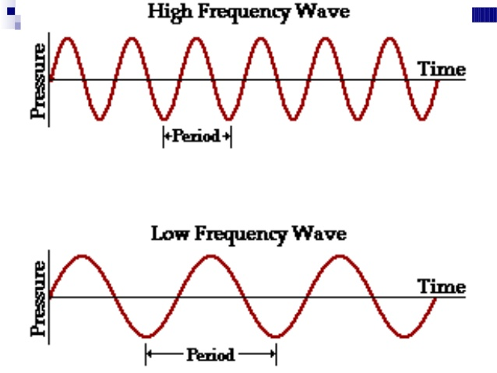
Determining Wave Speed
Formula: v = f . λ
Velocity/speed = Frequency Wavelength
m/sec = Hz m/cm

Slide 10
Determining Wave Speed
1. What is the speed of a sound wave that has a wavelength of 2m and a frequency of 170.5Hz?

Slide 11
Determining Wave Speed
2. The speed of a wave on a rope is 50cm/sec and its wavelength is 10cm. What is the frequency?

Slide 12
Determining Wave Speed
3. The speed of an oncoming ocean wave is 6cm/sec. The length between two successive wave crests is 3m. What is the wave’s frequency?

