Slide 1
Physical Properties Lab
We did not get to the block (bottom row) so here is a series of pictures to help you….

Slide 2
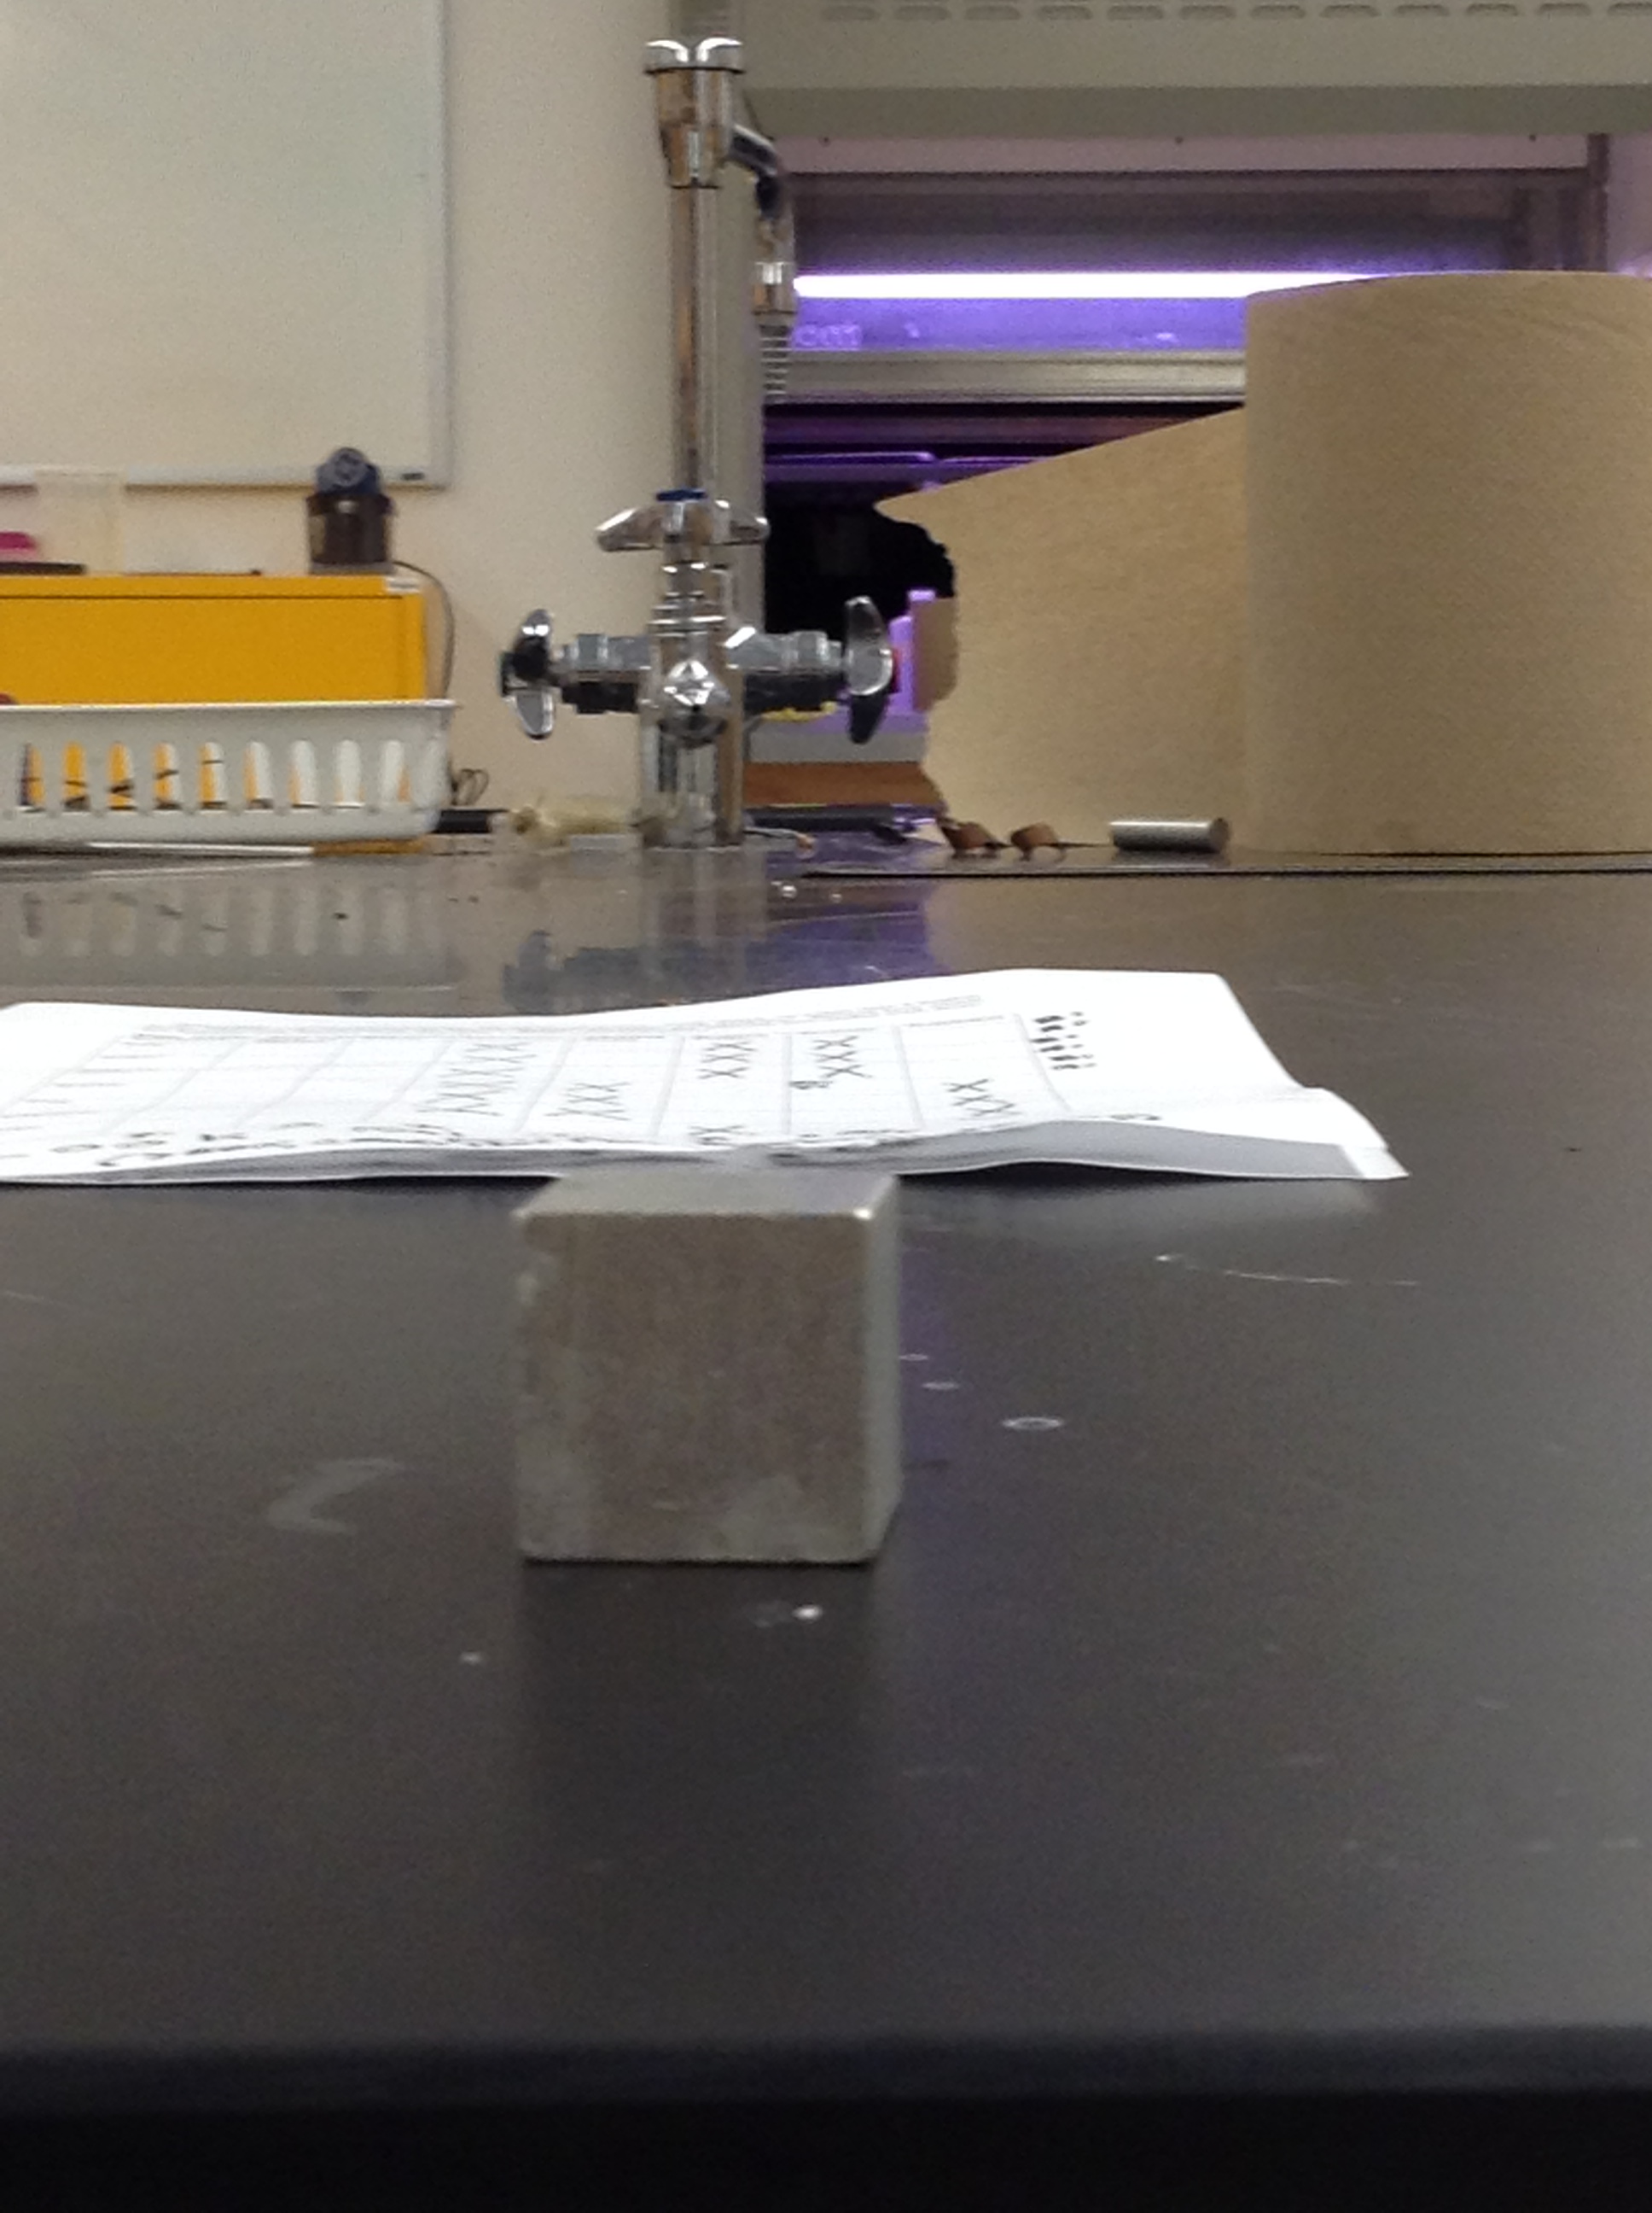
Here is the block
Determine State, Color, and Hardness.

Slide 3
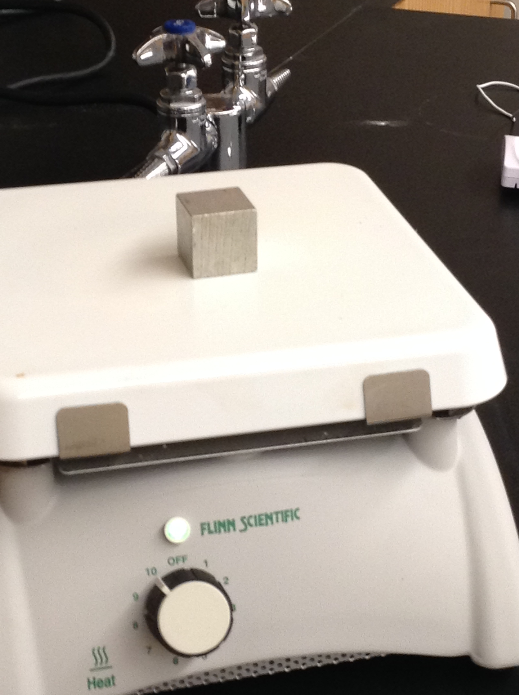
Here is the block on a hot plate after 2 minutes…
Determine the melting point
( >500 or <500)

Slide 4
To Calculate Density – Remember: D = M/V So we need the mass and the volume of the cube.

Slide 5
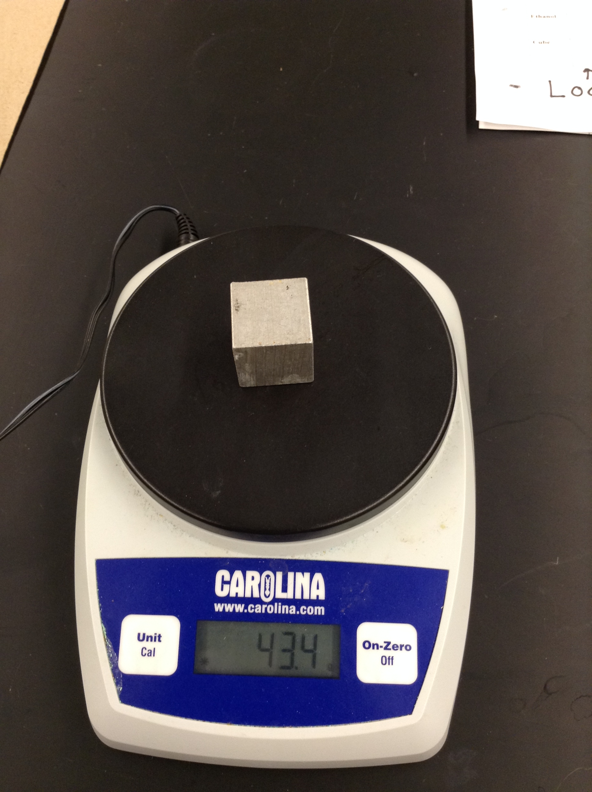
Here’s the block on a balance…
Read the mass in grams.

Slide 6
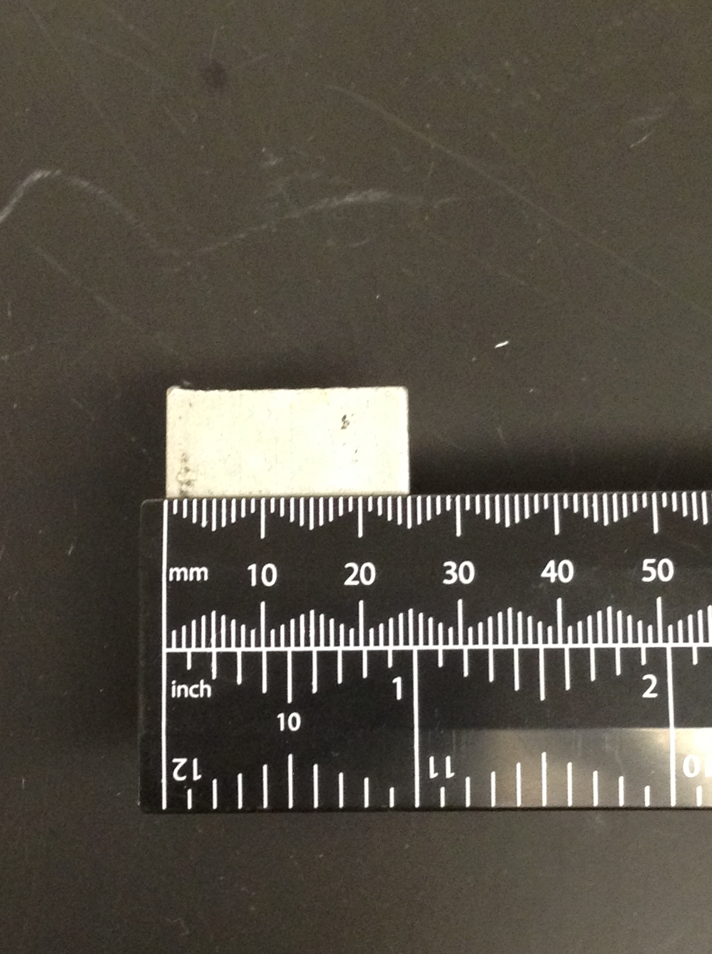
Here’s the block with a ruler:
How long is a side in cm?
Volume of a cube = s x s x s
Volume =

Slide 7
Now you can use D = M/V to calculate density. See the finished copy on the desk if you have any other questions. Then answer questions 1-5 and turn in the lab. If you finish start on Classification of Matter Studyguide – use your book!

