Slide 1
Newton’s 3rd Law

Slide 2
A force is a push or a pull that acts upon an object as a result of its interaction with another object
You must have two objects come in contact to have a push or a pull

Slide 3
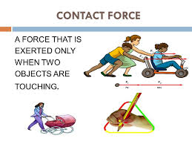
some forces result from contact
interactions (normal, frictional, tensional, and applied forces are examples of contact forces)

Slide 4
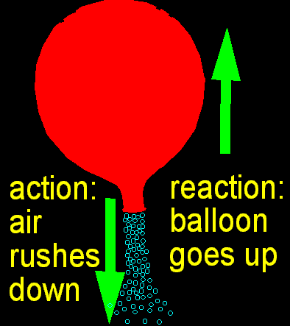
Newton’s 3rd Law: “For every action, there is an equal and opposite reaction”
That means:
that in every interaction, there is a pair of forces acting on the two interacting objects

Slide 5
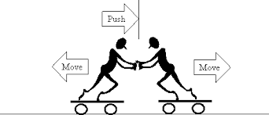
size of the forces on the first object equals the size of the force on the second object

Slide 6
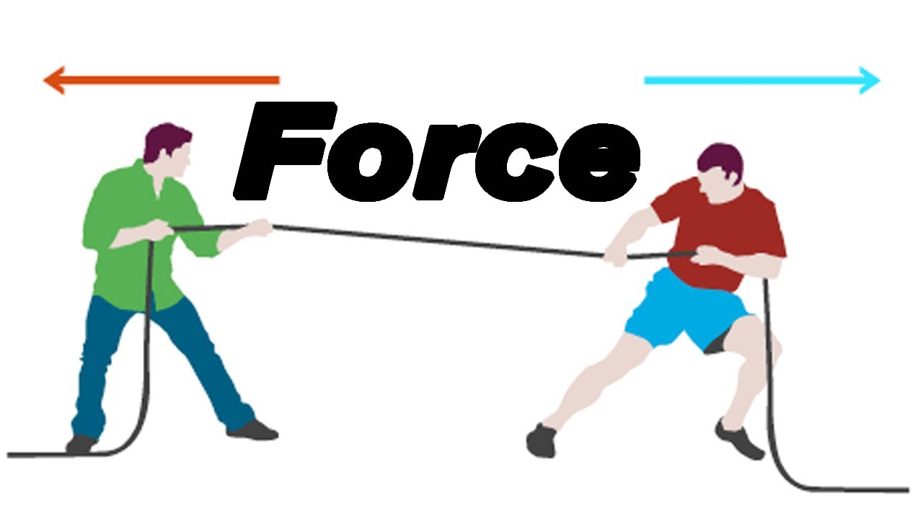
direction of the force on the first object is opposite to the direction of the force on the second object

Slide 7
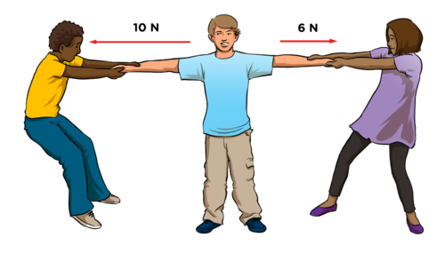
Forces always come in pairs - equal and opposite action/reaction force pairs

Slide 8
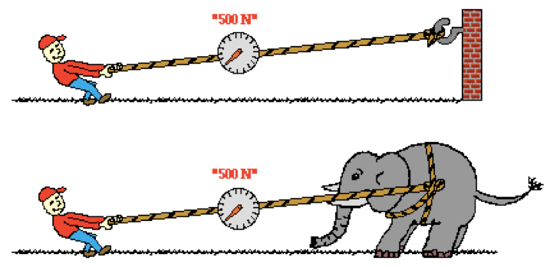
In the top picture (below), Kent Budgett is pulling upon a rope that is attached to a wall. In the bottom picture, Kent is pulling upon a rope that is attached to an elephant. In each case, the force scale reads 500 Newton. Kent is pulling …
A. with more force when the rope is attached to the wall.
B. with more force when the rope is attached to the elephant.
C. the same force in each case.

